Slide 1






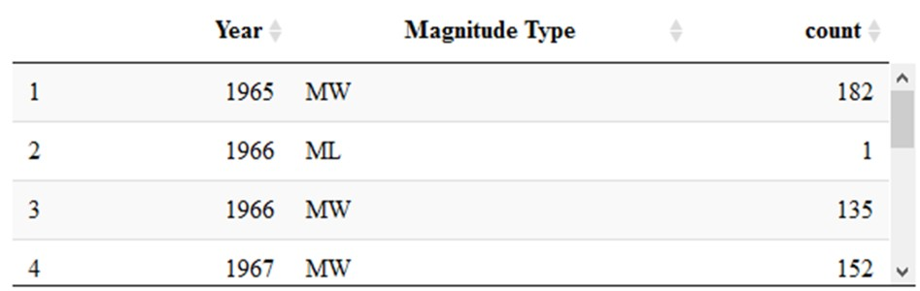
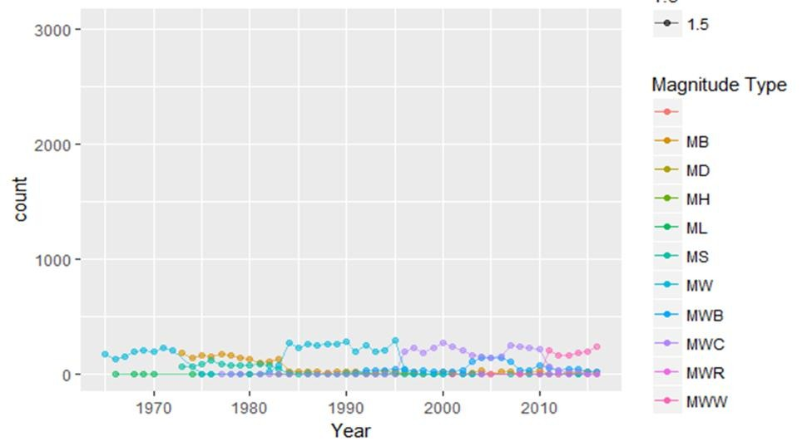
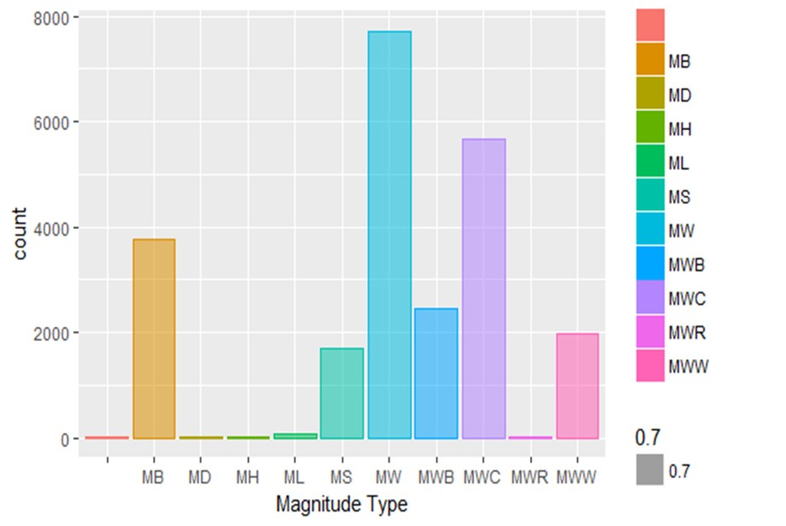
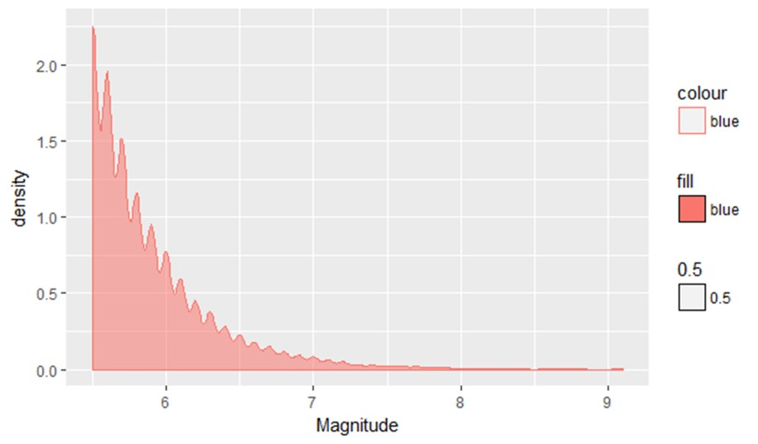

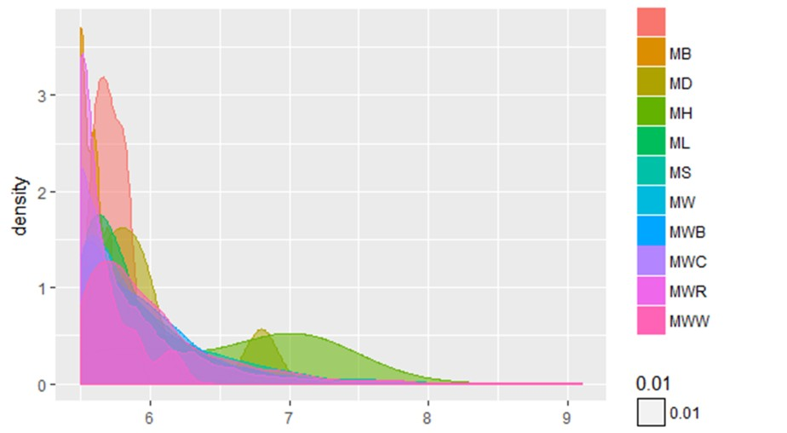

EARTHQUAKE ANALYSIS FROM 1965-2012 USING CLUSTERING
`
INTRODUCTION
DATA AT GLANCE
Results
The National Earthquake Information Center (NEIC) determines the location and size of all significant earthquakes that occur worldwide and disseminates this information immediately to national and international agencies, scientists, critical facilities, and the general public.
The NEIC compiles and provides to scientists and to the public an extensive seismic database that serves as a foundation for scientific research through the operation of modern digital national and global seismograph networks and cooperative international agreements.Here we can use stastistical and machine learning approaches to predict the earthquakes.
Year wise earthquake count
Amount of earthquakes observed according to magnitude type
Magnitude type and count
Reported magnitude 5.5 or higher since 1965
OBJECTIVES
Analysis of different earthquakes depending
on their intensity.
Evaluation of earthquake depending on date, time, location, depth, magnitude, and source.
Density can be predicted with respect to the count
CONCLUSION
Earthquake data includes the record of date,location,
depth and magnitude of all the earthquakes starting from 0.5 and higher intensity. This can analyse the entire count of the earthquakes around the world.
Analysis of world wide cause of earthquake.

